Slide 1
ODDS & ENDS
“TEST PREP”

Slide 2
WHAT’S THE POINT?

Slide 3
How many Line SEGMENTS between 2 POINTS?
ONLY ONE SINCE
POINTS HAVE NO AREA!

Slide 4
How many Line SEGMENTS between 2 POINTS?
ONLY ONE

Slide 5
Take 6 POINTS & CONNECT EVERY PAIR
5
4
3
TOTAL = 15
2
1

Slide 6
PERIMETER & AREA
$$\frac{P}{A}=\frac{8}{4}=2$$
$2×2=4$AREA
$2+2+2+2=8$ PERIMETER
A=4, P=10 so $\frac{P}{A}=\frac{10}{4}=2.5$
A=4, P=16 so $\frac{P}{A}=\frac{16}{4}=4$

Slide 9
Is there a majority ?

Slide 10
Pick a random teacher
Is nano tech
(1) more likely than not
Or
(2)less likely than not
to be chosen?

Slide 13
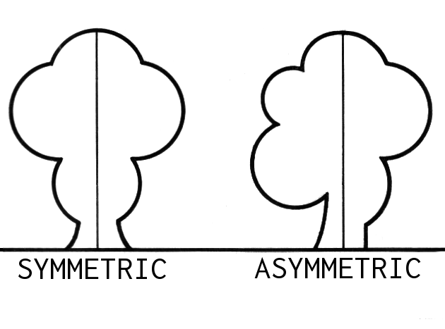
LINES OF SYMMETRY

Slide 14
MITSUBISHI

Slide 15
VOLKSWAGON

Slide 16
CBS

Slide 17
WAL-MART

Slide 18
NO SYMMETRY
Yin Yang

Slide 19
MIDNIGHT CONFUSION
TODAY IS JULY 28
IS MIDNIGHT JULY 28
TONIGHT OR LAST NIGHT?
MIDNIGHT IS THE
START OF THE DAY

Slide 20
You have an urn with 3 red and 2 green balls. Pick two at random – don’t replace the first ball before picking the second
WHAT IS
PROBABILITY
OF GETTING
ONE BALL
OF EACH COLOR?

Slide 21
Probability one of each=$\frac{6}{10}=\frac{3}{5}$
$$\frac{1}{4}$$
$$\frac{2}{5}×\frac{1}{4}=\frac{2}{20}=\frac{1}{10}$$
$$\frac{2}{5}$$
$$\frac{3}{4}$$
$$\frac{2}{5}×\frac{3}{4}=\frac{6}{20}=\frac{3}{10}$$
$$\frac{2}{4}=\frac{1}{2}$$
$$\frac{3}{5}×\frac{1}{2}=\frac{3}{10}$$
$$\frac{3}{5}$$
$$\frac{2}{4}=\frac{1}{2}$$
$$\frac{3}{5}×\frac{1}{2}=\frac{3}{10}$$

Slide 22
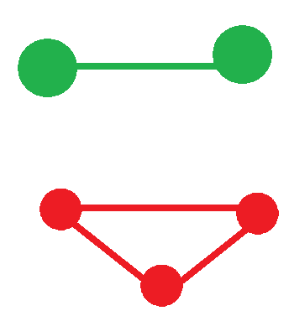
HOW MANY LINES BETWEEN
5 POINTS?
Each line
Is one pair
that can
be chosen
10

Slide 23
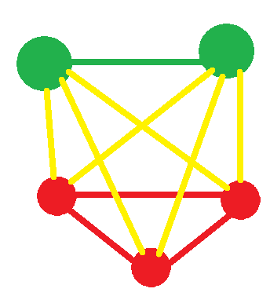
HOW MANY LINES BETWEEN
5 POINTS?
10
$\frac{YELLOW LINES}{TOTAL LINES}$=$\frac{6}{10}=6$0%

Slide 24
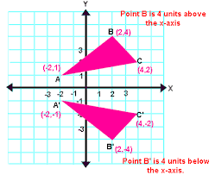
REFLECTION
ABOUT
X-AXIS
TRIANGLE
FORMED BY
(-2,1),(2,4)
And
(4,2)

Slide 25
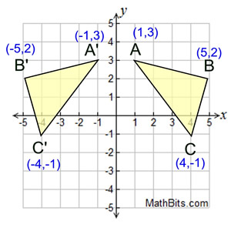
REFLECTION
ABOUT
Y-AXIS
Consider triangle
formed from
(1,3), (5,2)
&
(4,-1)

Slide 26
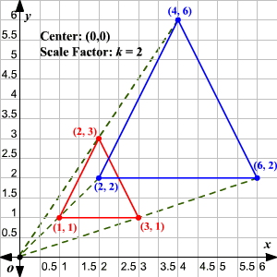
DILATION
BY
FACTOR OF 2
CONSIDER
TRIANGLE FORMED
BY
(1,1),(2,3)
& (3,1)

Slide 27
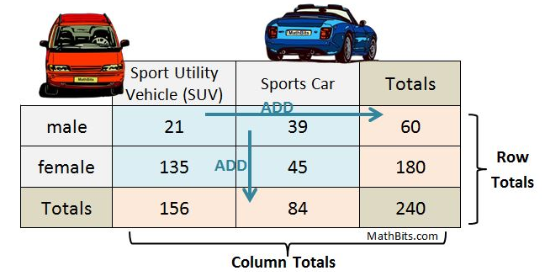

Slide 28
PERCENTAGE
CHART
8.75%
16.25%
25%
56.25%
18.75%
75%
65%
35%
100%

